Slide 1
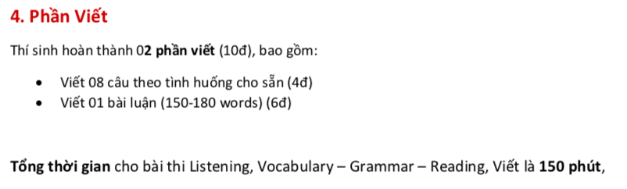

Slide 2
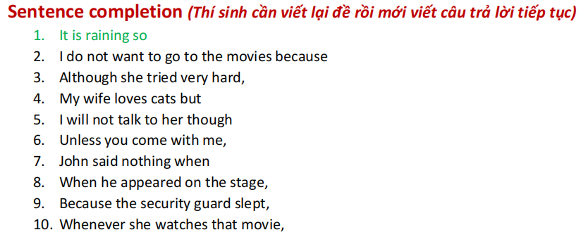

Slide 3
It is rainning, so I stay at home.
I don’t want to go to the movie because I feel tired
after studying at school.
3. Although she tried very hard, she couldn’t get high score
for the exam.
4. My wife loves cats but she doesn’t want to have one in
our house.
5. I will not talk to her though she makes up after our argument.
6. Unless you come with me, I won’t go to the party tonight.
7. John said nothing when his teacher asked him to answer
the question.

Slide 4
8. When he appeard on the stage, the audience gave him
a big applause.
9. Because the security guard slept, the thief entered the house
and took all of the money.
10. Whenever she watches that movie, it reminds her of her
childhood.

Slide 5
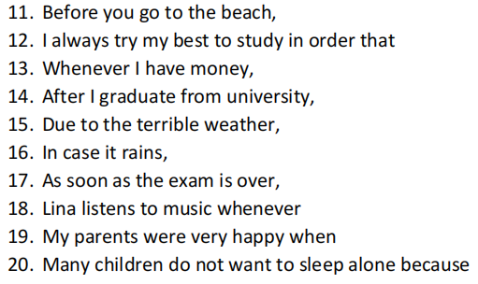

Slide 6
11. Before you go the beach, remember to apply suncreen
and bring a hat.
12. I always try my best to study in order that I can get
a better job in the future.
13. Whenever I have money, I will spend on clothes and food.
14. After I graduate from university, I am going to apply for a job.
15. Due to the terrible weather, we can’t go to the beach today.
16. In case it rains, I will bring an umbrella.

Slide 7
17. As soon as the exam is over, I will have a holiday with
my family.
18. Lina listens to music whenever she has free time.
19. My parents were very happy when I graduated from
the university.
20. Many children do not want to sleep alone because
they are afraid of the dark.

Slide 8
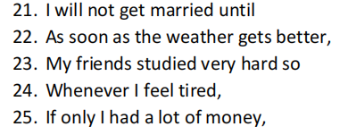

Slide 9
21. I will not get married until I am 26 years old.
22. As soon as the weather gets better, we will go to
the beach.
23. My friends studied very hard so they passed the exam.
24. Whenver I feel tired, I will take a rest.
25. If only I had a lot of money, I could buy a new house.

Slide 10
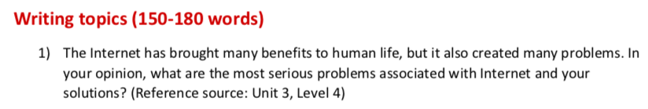

Slide 11
Our lives have been developed by the Internet and the way we can share information with others around the world so easily. However, a number of problems have emerged as a result of this. This essay will discuss a few of the most significant problems and offer some possible solutions.
The first advantage of the Internet is the effective communication with people around the world through the world wide web, social media or e-mail. These tools have allowed us to easily communicate and share information. Another advantage is the huge amount of information that help us widen our knowledge by using searching engines, websites dedicated to different subjects.
However, there are a number of issues that have been created through widespread use of the internet. One of the biggest issues is the way it is used by cyber-bullies. They post private or false information about people and verbally abuse them, which can have serious consequences, even suicide. One solution could be to educate people about the correct and appropriate use of the internet. The education should focus on cyber-bullying and the drastic consequences it can have for the victims.
Another major problem is the individual privacy. People’s personal and even financial information can sometimes be shared, leading to theft and fraud. There should be software and laws in place to protect people’s private data. People should know that they cannot simply steal people’s online identity and data. In addition, we should create our passwords carefully to avoid hackers stealing our private information.
In conclusion, the internet can be a dangerous tool if it is not managed correctly. However, if it is used in the proper way it can be an incredible resource for everyone.

Slide 12


Slide 13
In the modern era, there is a rising need for people travelling by motorbikes instead of commuting to travel by cars or planes. It can be seen that there are several advantages and disadvantages of this phenomenon/ trend.
The first advantage of riding a motorbike to travel is its mobility on the route. It allows us to get to our destination even if it’s a place that is very difficult to access, which cars or planes cannot reach. Moreover, we can choose our own daily schedule, do not have to pay attention to transport schedules, and visit a place at our own pace.
Another advantage of travelling by motorbikes is the financial saving. If we travel by cars or planes, we must pay higher amount of money for the cost of petrol, the regular maintenance fee, taxes and flight tickets. These fee are much more expensive than those of a motorbike.
However, there are some disadvantages with travelling by motorbikes. The first drawback of riding a motorbike to travel is its inconvenient conditions. To be more specific, it does not have air conditioning and a windshield wiper to help us feel comfortable and not be affected by harsh weather conditions. In addition, we cannot carry three or more people, luggage and many things when using a motorbike. Therefore, having limited space to sit and carry things can sometimes cause inconveniences to travel.
Another disadvantage of having a holiday by motorbikes is the unsafety on the journey. Particularly, we are securer when protected by the metal layer of the tires and security systems in cars or planes. In addition, fatigue is also caused for concern. Driving a motorbike to travel in a long distance can cause tiredness and distraction while driving.
In conclusion, although there are some benefits of travelling by motorbikes, it can also bring many threats to human life compared to cars and planes. Any type of vehicle has different advantages and disadvantages during its usage, as is the case with motorbikes. We should consider the needs, financial capacity and other factors to choose the suitable means of transport for travelling.

Slide 14


Slide 15
With the development of technology, more and more robots and machines are used in various fields. Many people hold the opinion that machines will replace humans in the future. On the other hand, other people have a conflicting view that machines can’t do many of the jobs that humans do today. I totally agree that machines can’t replace humans.
Machines have more advantages that over humans in many aspects. Firstly, automation is expected to increase the efficiency and productivity in working conditions especially in manual labor. This is because jobs that involve manipulating small objects can be easily and rapidly performed by robots and machines. They also can implement a wide variety of tasks successfully in a record time compared to human performance. Secondly, machines have played an important role in the safety at workplaces. Particularly, there are so many high-risk fields that machines can replace laborers and workers, who are facing hard and perilous working conditions in factories or constructive sites. Therefore, machines can increase safety because it could be a serious issue if a laborer is injured while working on an unsecure job.
However, there are some strengths and skills that machines cannot perform compared to human beings including creativity, imagination and social skills. Firstly, machines are not capable of the same level of creativity and imagination as humans, and even if they were, some tasks are better performed by people rather than machines. To be more specific, they cannot think independently from what they have been programmed to do. In addition, a machine cannot be able to take specific decisions when there is an issue like people can.
Secondly, machines can’t have the ability of solving unexpected problems in social situations and interact with other workers. For instance, they can’t discuss or express their ideas in a meeting and negotiate with customers about an issue at the working environment. Moreover, they don’t have connections with other people and take responsibility at work compared to humans.
In conclusion,/ To sum it all up, it is personally disagreed that machines can take human beings places in working conditions. Furthermore, it is better to manufacture machines to assist workers in achieving their tasks successfully rather than replacing them.

Slide 16


Slide 17
Leisure time is necessary for people after working and studying hard especially in the rapid development of the society. I personally spend my free time to do both mental and physical activities.
There are two categories that I spend my leisure time including mental and physical activities. In term of mental activities, it is better for me to read books, newspapers, write letters, visit a library, attend a play or play games such as chess or puzzles. These activities are all simple and can contribute to a healthier brain. I enjoy reading books in my free time because they help me expand my knowledge. Moreover, I am also keen on playing chess with my sister at home. These activities help me relax and release stress after a long day at work and school.
Another kind of free time activities that I often do when I have time is physical activities. Playing sports such as football, volleyball or swimming is one of the interesting ways for me to improve my health and strengthen relationships with my teammates. In addition, I also go camping or have a picnic at the park near my house with my family at the weekend. At that time, we can enjoy our food and drinks, share about our working and school life with each other. These moments with our friends and beloved ones are unforgettable and precious.
In conclusion, doing leisure activities can help us improve our health and enhance our relationships with our surrounding people. Personally, participating in outside and inside pursuits is the best way for me to maintain my both metal and physical health in the limited amount of time.

